Slide 1
County Clear Cr Wilderness 4 Mile Rasp Shavano

Slide 2
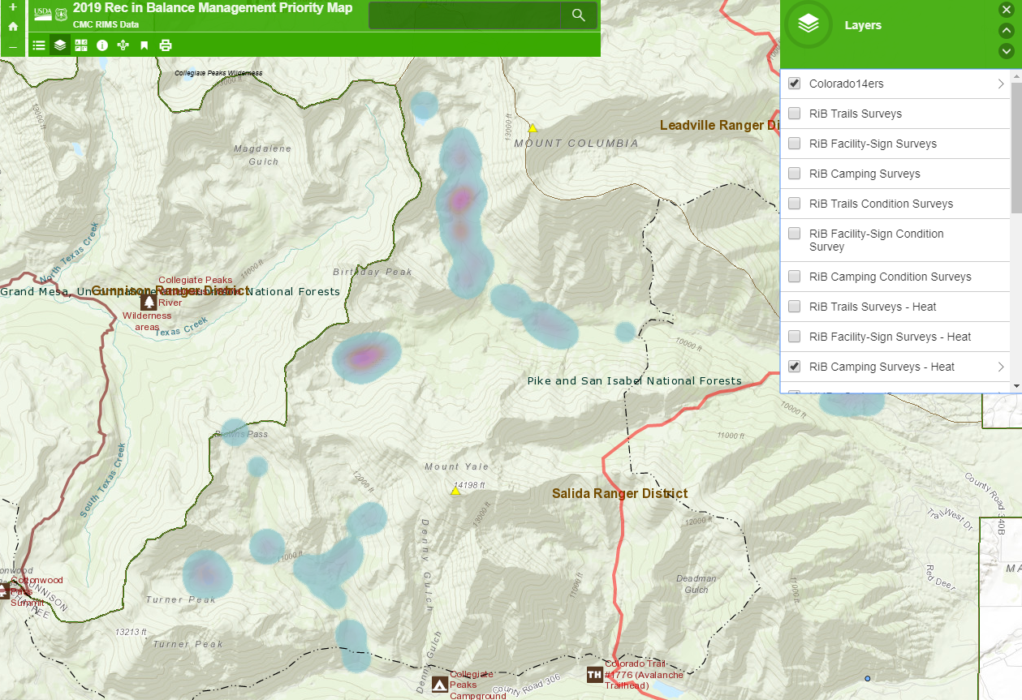
Wilderness – Horn Fork and Denny

Slide 3
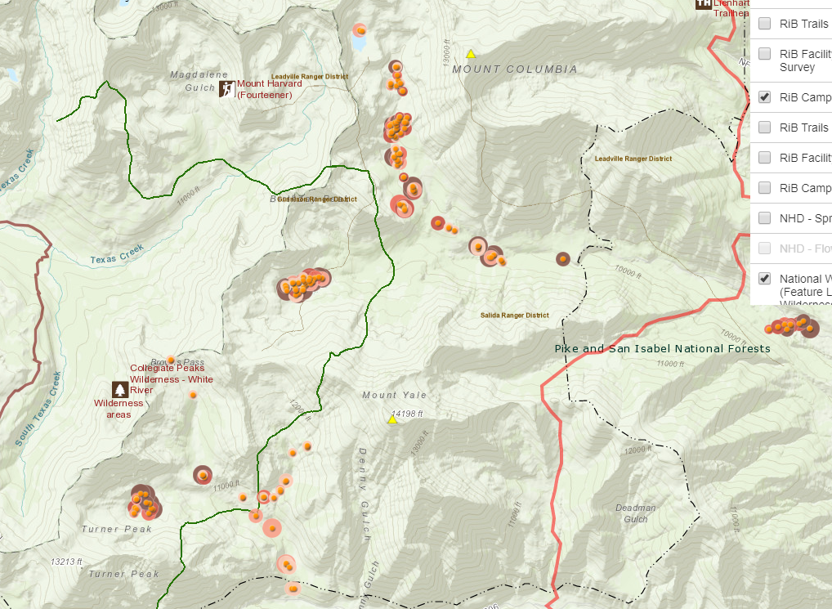
Wilderness – Horn Fork and Denny

Slide 4
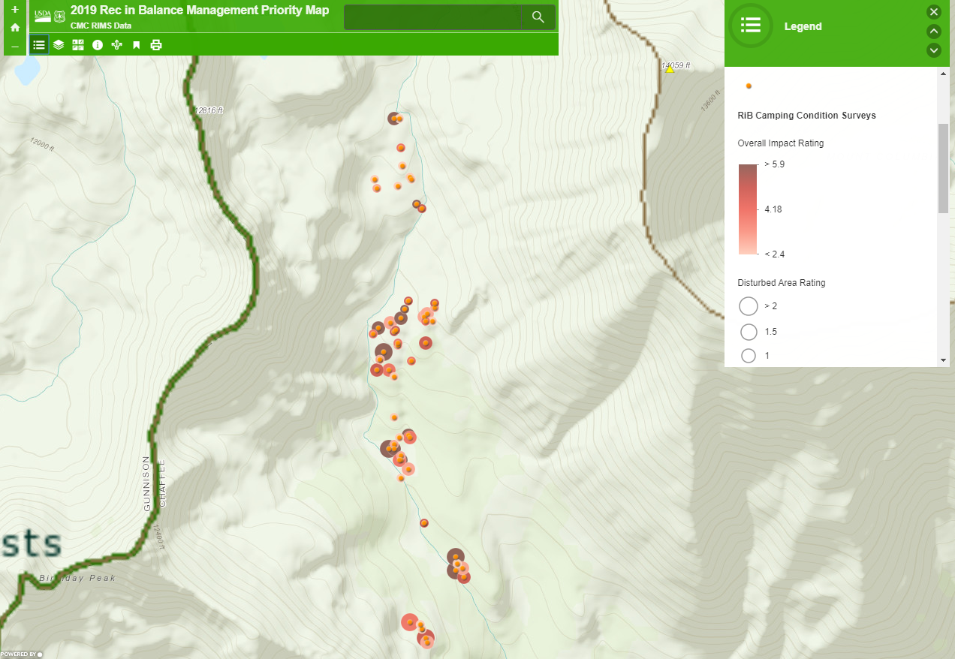
Hornfork: +50 sites, tree damage

Slide 5
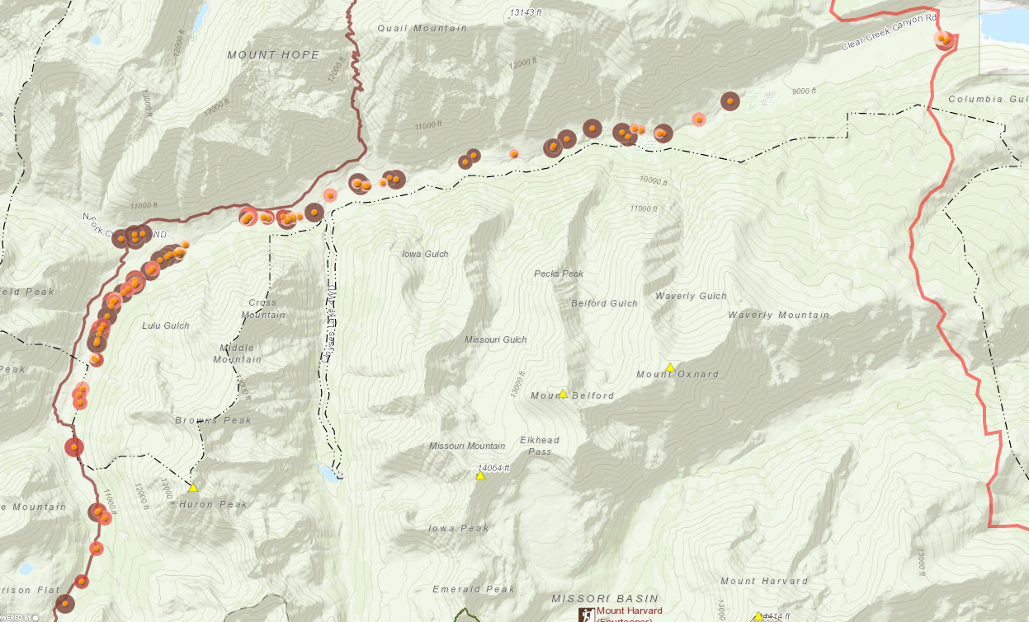
Motorized Access – Clear Crk +70

Slide 6
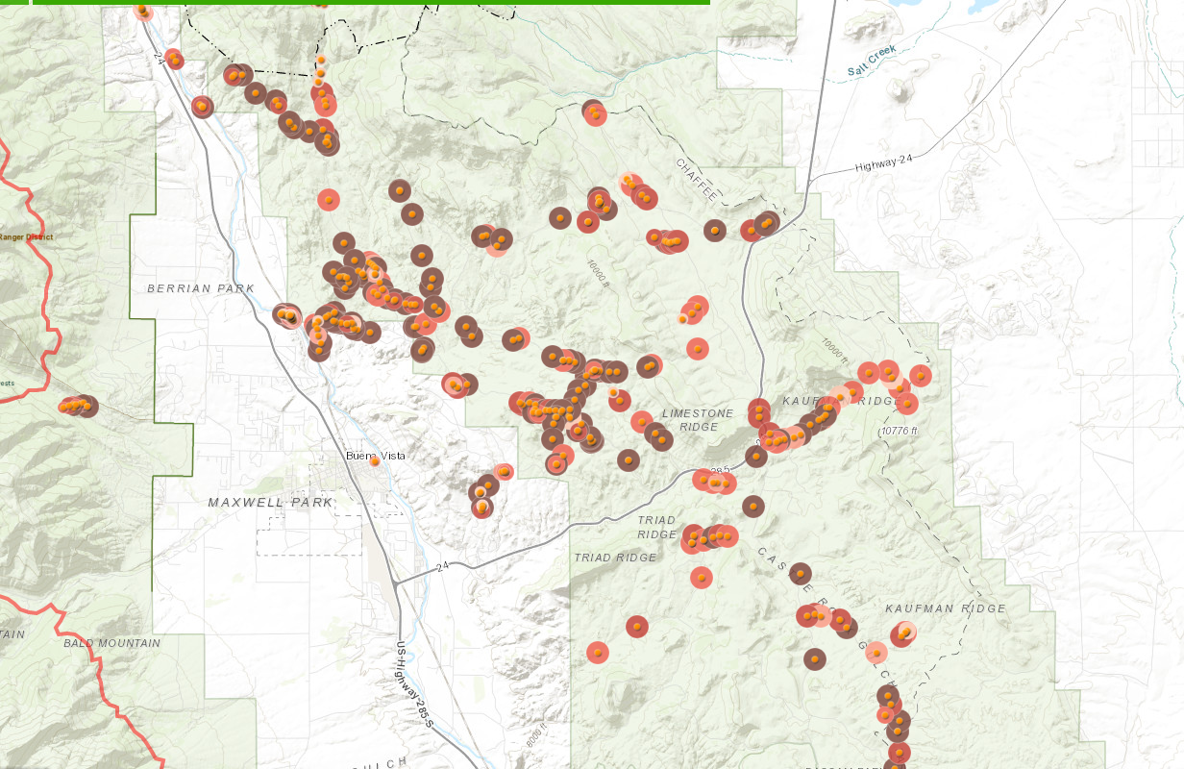
Four Mile

Slide 7
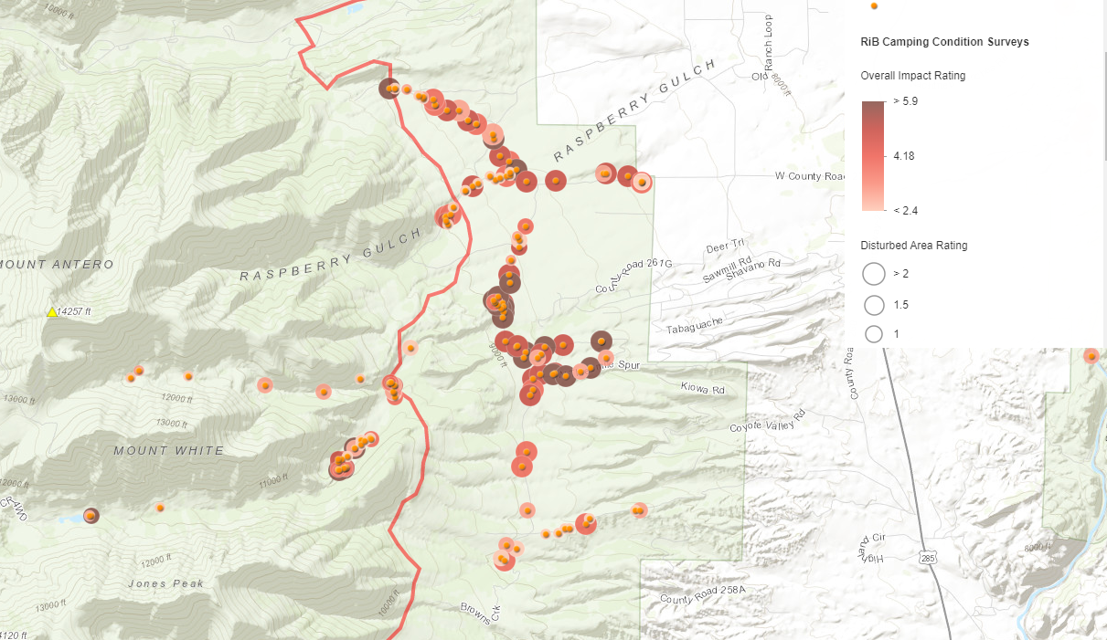
Raspberry Gulch

Slide 8
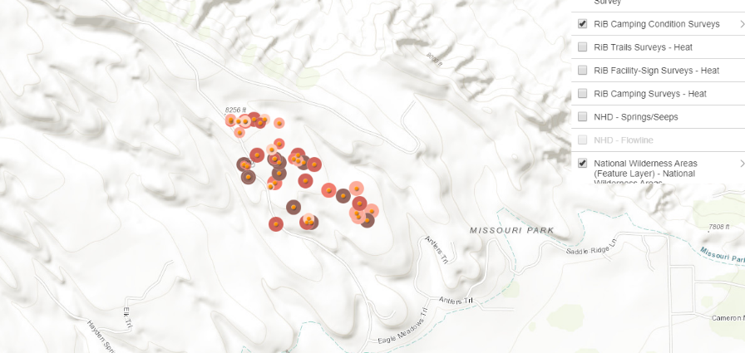
Shavano

